Slide 1

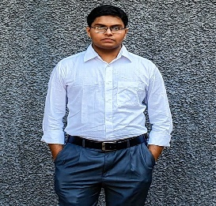
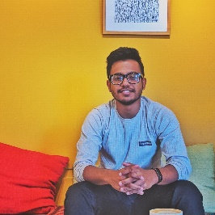
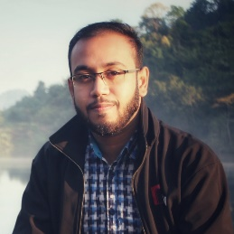
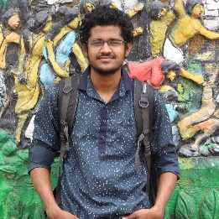
Online Nuclear Dilemma-2
CHIEF ENGINEER OF THE NPP
Team Arkansas
Team Members
Mohiuddin Khan
IUT | EEE
Rezuanur Rahman Dip
IUT | EEE
Farhan Shahriyar Haq
IUT |EEE
Faisal Hossain Reevu
IUT | EEE

Slide 2


Desalination sea water with small Nuclear Reactor
Radioactive water?
Expensive?
Waste of Energy Resources?
Brine water?
Greenhouse gas emission?
A Safe Solution to Water Crisis?

Slide 3
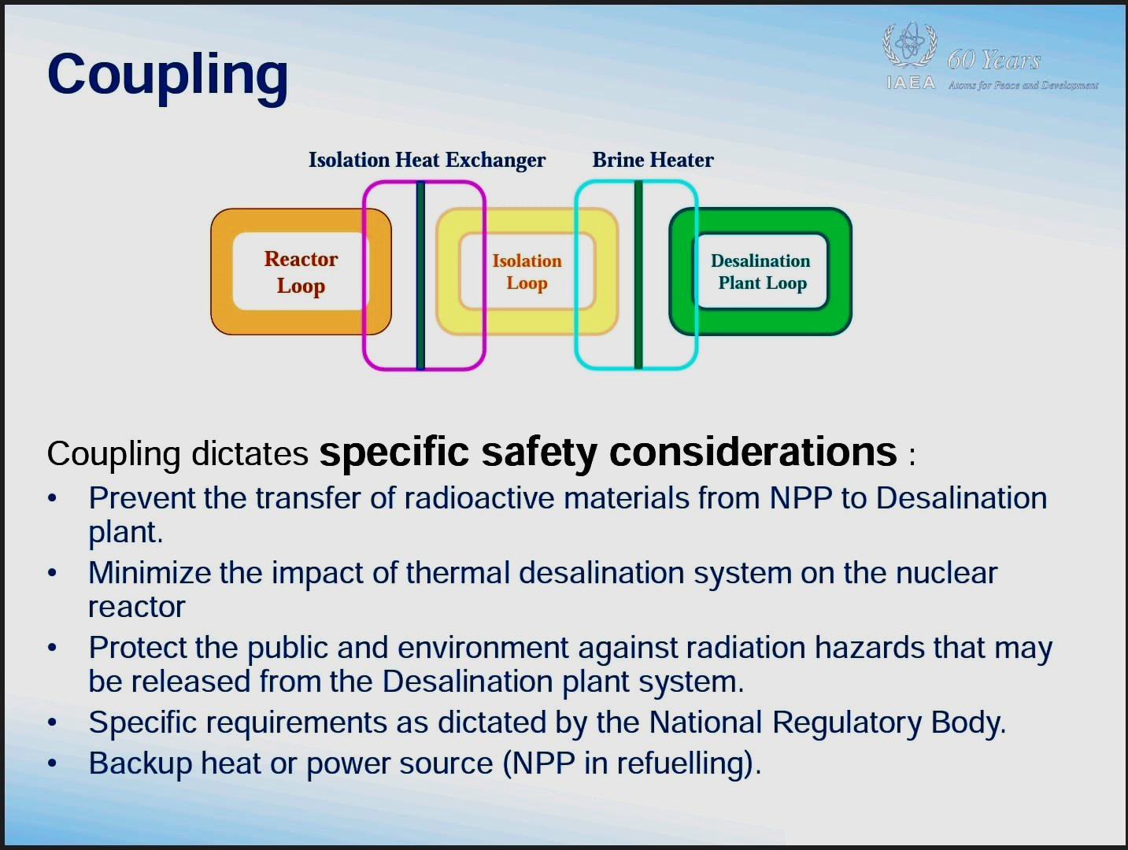

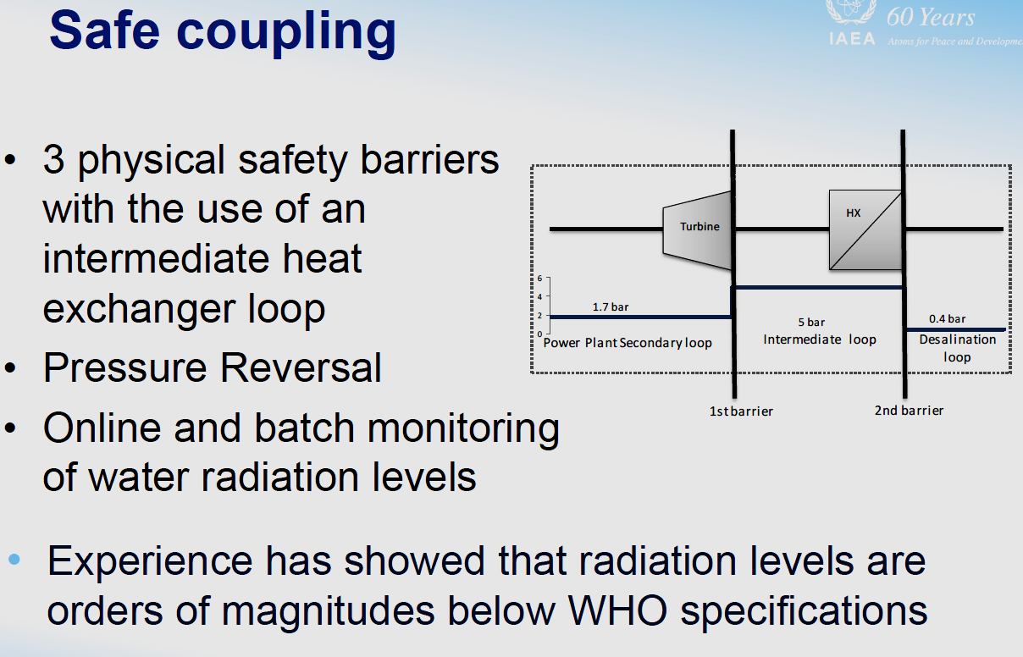
Delivered Fresh water is not radioactive

Slide 4
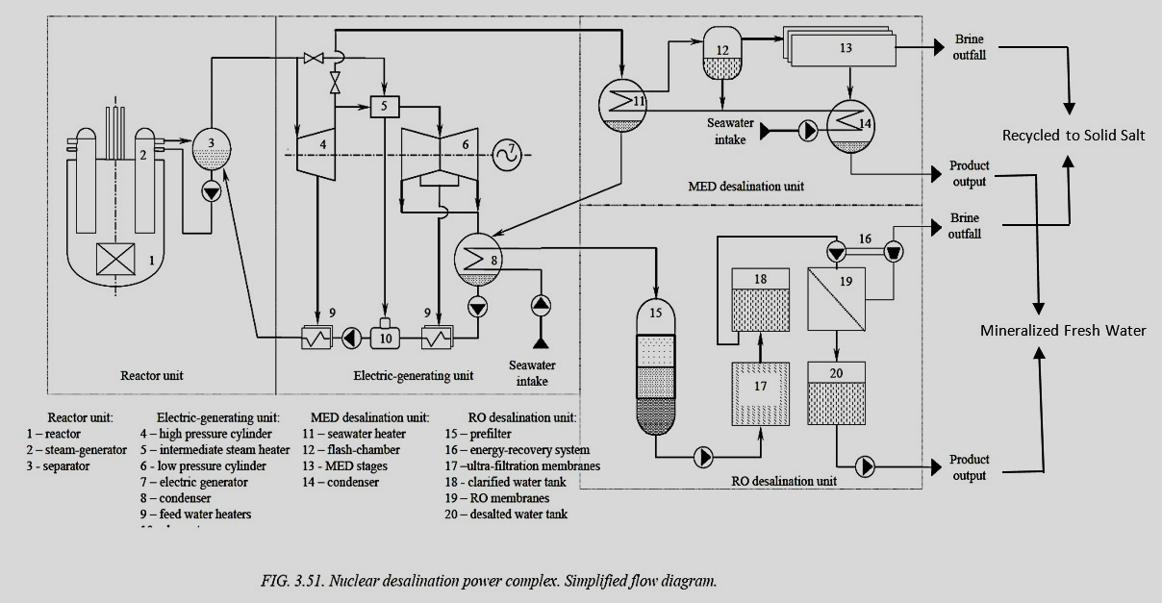
Methnani, M., and R. Faibish. Status of design concepts of nuclear desalination plants. IAEA-TECDOC-1326, International Atomic Energy Agency, Vienna, Austria, 2002.

Slide 5
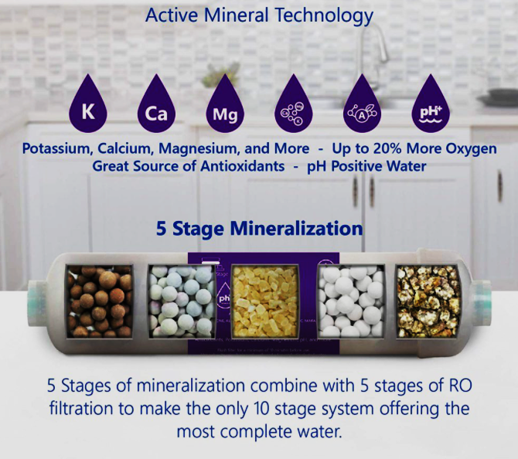
Mineralized!
Total 200 ppm
minerals added…

Slide 6
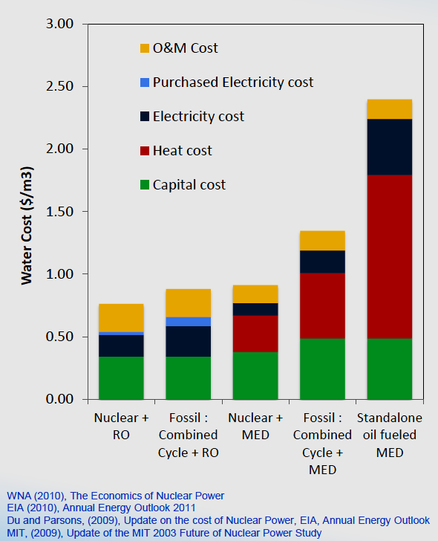

Expensive but Worthy
Power generation
Desalination

